Slide 1
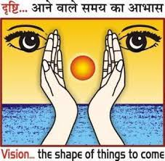

QR CODE GENERATOR
1
Presented by:
Mr. Abdurrahman Ansari
(C.S. 2nd year)
Ms. Anshika (C.S. 2nd year)
Mr. Sujeet Kumar(C.S. 2nd year)
Supervisor:
Mrs. Ayushi Nigam (H.O.D. Computer Science)

Slide 2
contents
2
2
Introduction​
History of QR code
How QR Works
Components used
Brief details of libraries
Working
Use Cases
Future scopes
Running the Program
QR CODE GENERATOR USING PYTHON

Slide 3
Introduction
3
QR (Quick Response) code system was invented in 1994 by Masahiro Hara.
Initially its purpose was to replace old bar codes. Like other 2-D barcodes, the QR code has good fault tolerance. Even if some part of the code is damaged, information can still be decoded from the code. QR code can store a large amount of information, unlike 1-D barcodes
Our Project
We have made the QR Code Generator by using the Python Language and it’s libraries and modules for Back-end and Front-end programming.
QR CODE GENERATOR USING PYTHON

Slide 4
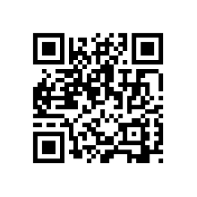
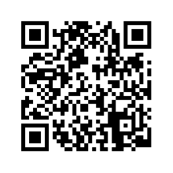
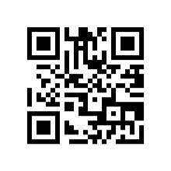
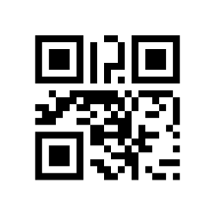
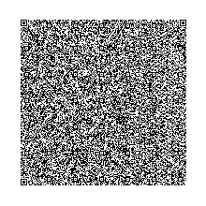
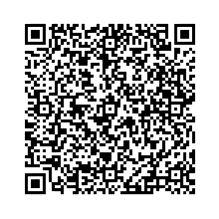
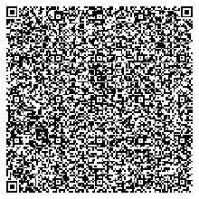
4
HISTORY OF QR CODE
The QR (Quick Response) code system was invented in 1994 by Masahiro Hara for replacing the old barcode and provide much faster and efficient code.
Version 1 (21×21)
pixel
Version 2 (25×25)
pixel
Version 3 (29×29)
pixel
Version 4 (33×33)
pixel
Version 10 (57×57)
pixel
Version 25 (117×117)
pixel
Version 40 (177×177)
pixel
QR CODE GENERATOR USING PYTHON

Slide 5
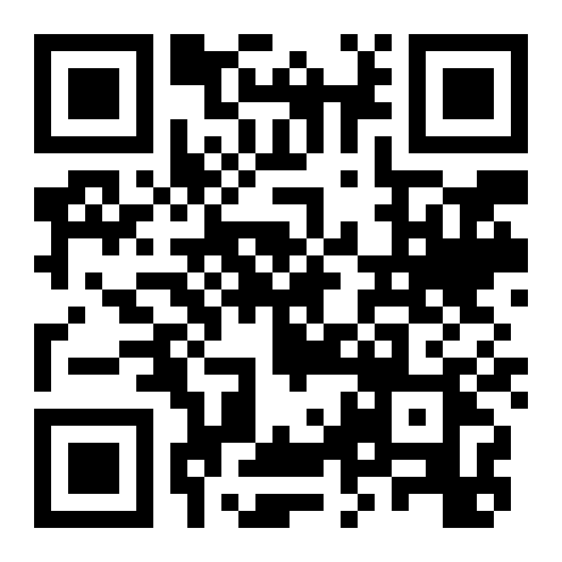
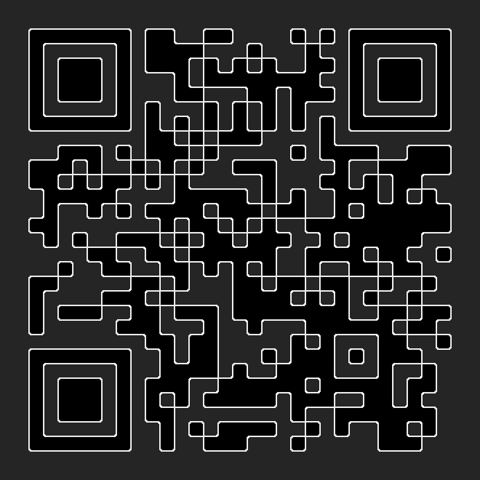
How qr code works
5
Data Modules
Finder Pattern(Eyes)
Separators
Quite Space
Alignment Markers
Error Correction
Pattern Masking

Slide 6




components used
6
Visual Studio Code (IDLE)
tkinter:
A Python’s in-built library for creating the GUI (Graphical User Interface) of the application.
PIL (Python Image Library):
library for displaying an image of the QR to the user
qrcode:
A Python library for creating QR codes.
front-end programming
back-end programming
QR CODE GENERATOR USING PYTHON
This Photo by Unknown Author is licensed under CC BY-SA

Slide 7
Brief details of libraries
7
PYTHON IMAGE LIBRARY
Qr code library
Tkinter library
Pillow is a Python Imaging Library (PIL), which adds support for opening, manipulating, and saving images
This is a QR code generator library which automates most of the building process for creating QR code
Tkinter is the Python interface to the Tk GUI toolkit shipped with Python, which provides a fast and easy way to create GUI applications
QR CODE GENERATOR USING PYTHON

Slide 8
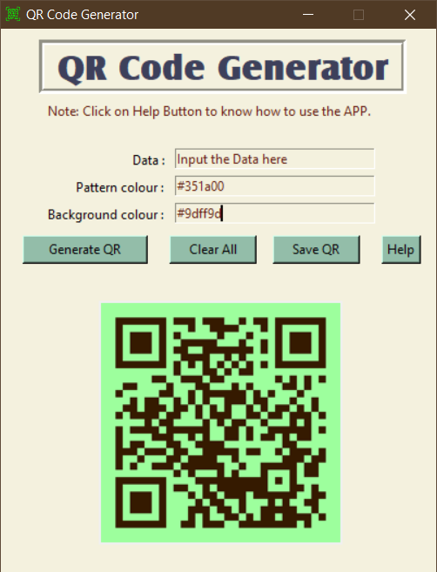
Working
8
8
Taking user input with Entry box
Taking colour of the QR pattern from user
Taking background colour of the QR
Generating the QR with qrcode library
Showing the generated QR to the user
Saving the QR as an image file
QR CODE GENERATOR USING PYTHON

Slide 9
USE CASES
9
QR code payment
Website login
E-authentication
Share discount coupons
Touchless system
Accept or request payments by using QR code of
UPI and Net Banking
QR codes can be used to log into websites
Like WhatsApp, Telegram login
QR codes are used to authenticate documents online without inserting the details for electronic authentication
If a business is selling offline, it can use the QR code printed on the product packaging to share the discount coupon with the customers
After the COVID-19 pandemic, QR codes began to be used as a "touchless" system to display information
QR CODE GENERATOR USING PYTHON

Slide 10


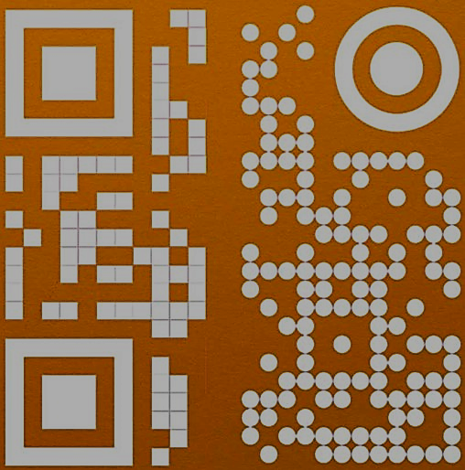
FUTURE SCOPES
10
image embedded QR
More customization
Dynamic qr
Insert your logo in QR
Image color based QR theme
Easy Identification of code
Easier to build the trust
Insert indications.
Change Colour/Gradient
Change data pattern
Change eye shape
Add image as background
Flexibility to change the URL linked to it, even after printing and distributing.
It stores a short dynamic URL on the QR code
Its performance can be tracked
QR CODE GENERATOR USING PYTHON

Slide 11
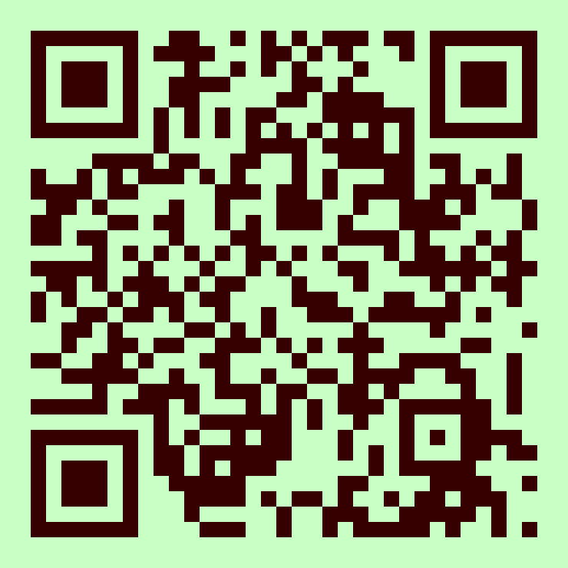


THANK YOU
11
From:
Mr. Abdurrahman Ansari
Ms. Anshika
Mr. Sujeet Kumar
QR CODE GENERATOR USING PYTHON

